Slide 1

Tuwaiq Academy
Data Science and Machine Learning Bootcamp
21-5-2023
Hisham Altayieb

Slide 2


Trips Reservation System
Tripny
A system for booking recreational trips in three cities.

Slide 3
Agenda
03
02
01
Used Libraries
Used Functions
Overview
06
05
04
Questions
Improvements can be done
Code walkthrough

Slide 4
Overview

Slide 5
Overview
The idea of the program is summed up in questions that are asked to the user who wants to visit one of the three main cities in the Kingdom for the purpose of tourism, and finally, you book the trip for the user.

Slide 6
Used Functions

Slide 7
Used Functions
Visit()
method()
timing()
Trip()
main()

Slide 8
Used Libraries

Slide 9
Used Libraries
Tkinter
Time
Built in libraries

Slide 10
Code walkthrough

Slide 11
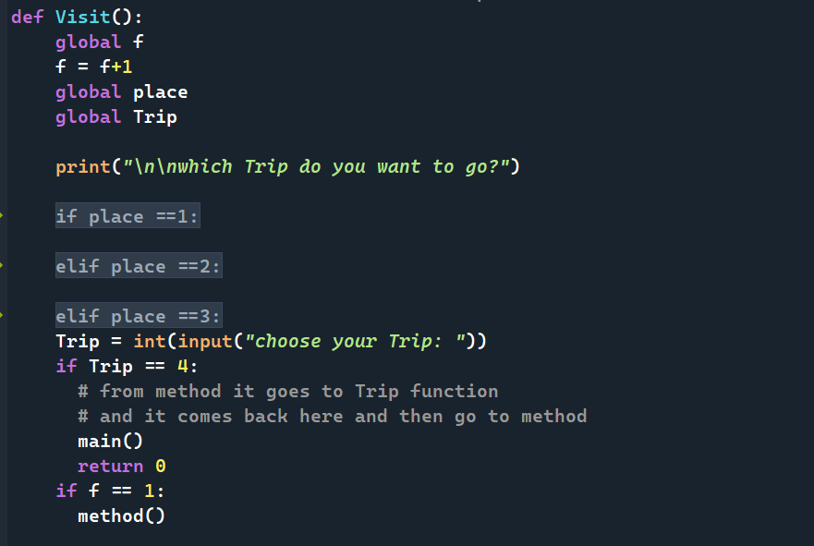
Code walkthrough Visit()

Slide 12
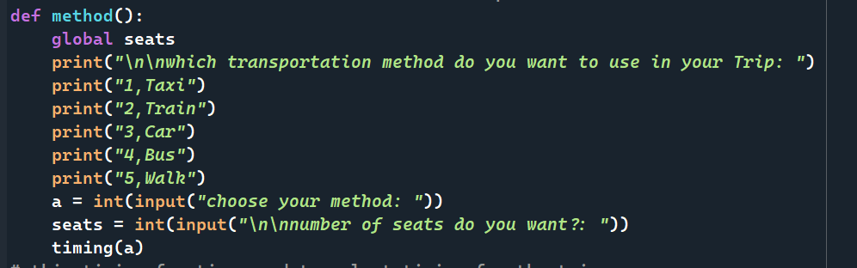
Code walkthrough method()

Slide 13
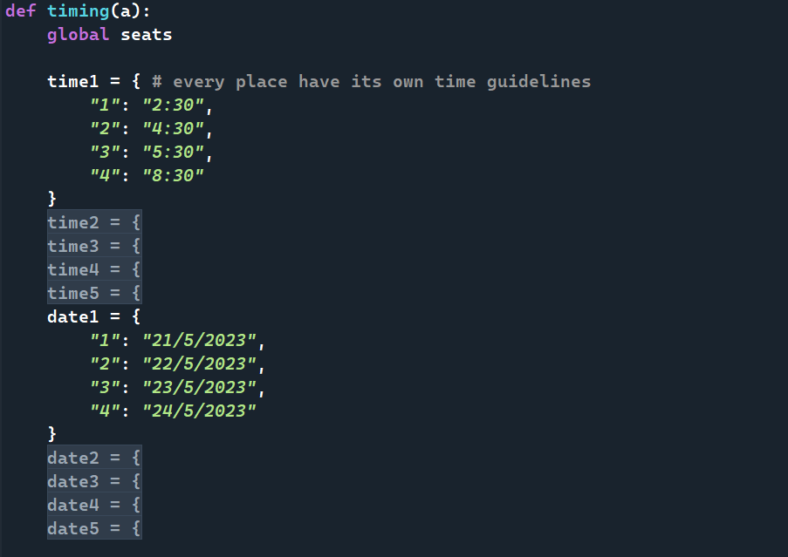
Code walkthrough timing()

Slide 14
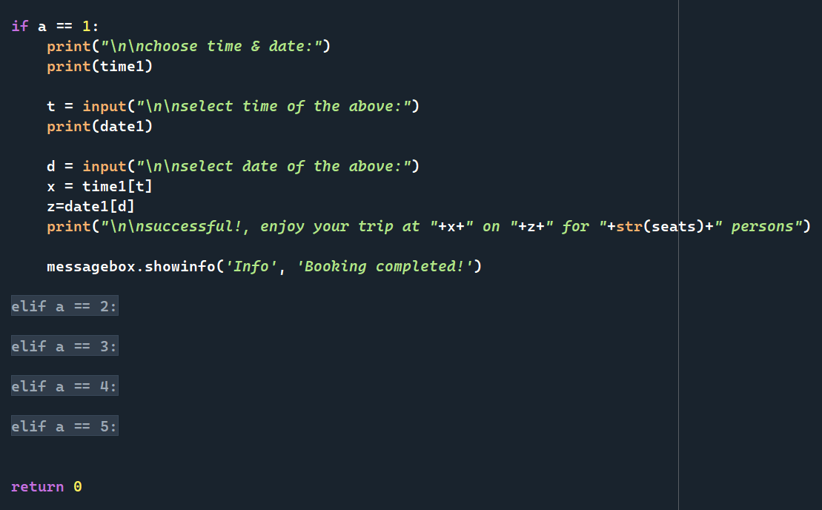
Code walkthrough Cont timing()

Slide 15
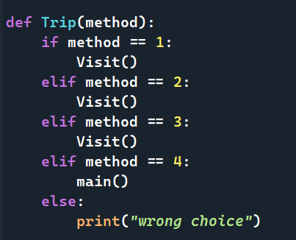
Code walkthrough Trip()

Slide 16
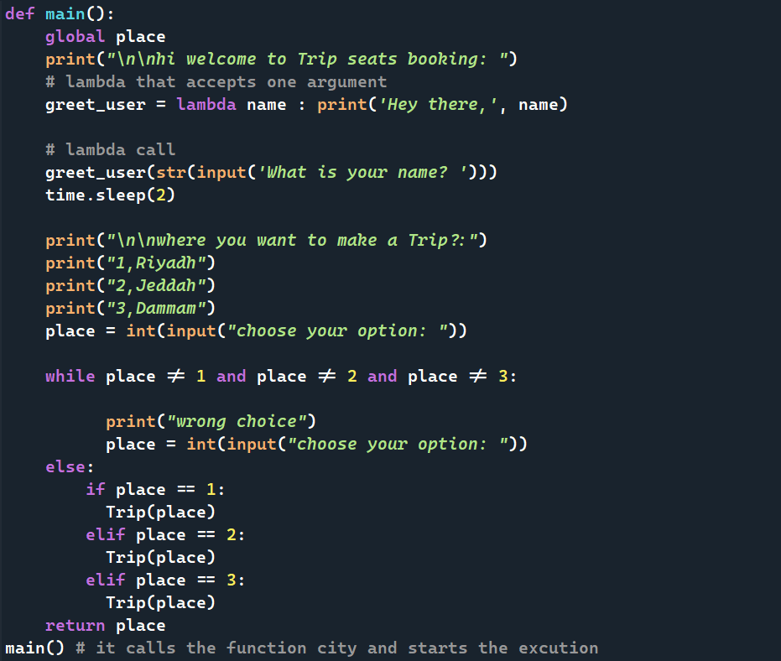
Code walkthrough main()

Slide 17
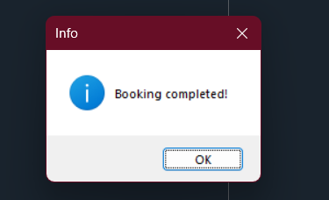
Code walkthrough GUI

Slide 18
Improvements

Slide 19





Improvements
Some improvements that may be added in the next stages.
Linking to a database
Recommend the most appropriate places for the user
Increasing the covered cities and adding categories for visits
Improve user interface

Slide 20
THANK YOU
شــــــكــــراً لكــــــم

Slide 21
Questions

